Slide 1
Digital Image Processing
Lecture 13: Color Image Processing

Slide 2
Color Models
The purpose of a color model (also called Color Space or Color System) is to facilitate the specification of colors in some standard way
A color model is a specification of a coordinate system and a subspace within that system where each color is represented by a a single point
Hardware Oriented
(RGB Model, CMY, CMYK)
Color Models
Application Oriented
(HSI Model)

Slide 3
Subtractive vs Additive Color Models
A subtractive color model explains the mixing of paints, dyes, inks, and natural colorants to create a range of colors
Each such color is caused by the mixture absorbing some wavelengths of light and reflecting others
Subtractive color systems start with white light.
Colored inks, paints or films placed between the viewer and the light source or reflective surface (such as white paper) subtract wavelengths from this white, and make a color.
Conversely, additive color systems start with no light (black). Light sources add wavelengths to make a color.

Slide 4
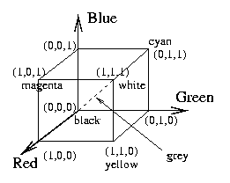
RGB Model
Each color is represented in its primary color components Red, Green and Blue
This model is based on Cartesian Coordinate System

Slide 5
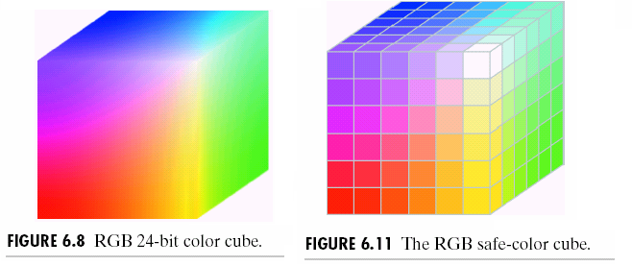
RGB Color Cube
The total number of colors in a 24 Bit image is
(2⁸)³ =16,777,216 (> 16 million)
In safe color cube we have 216 different colors….can be displayed on al most all devices

Slide 6
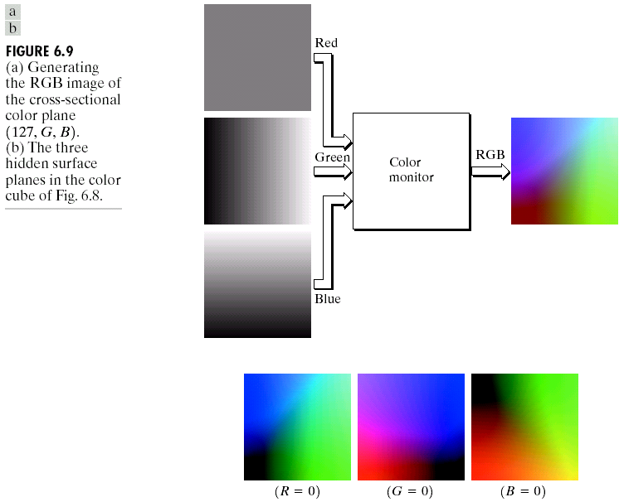
Generating RGB image

Slide 7
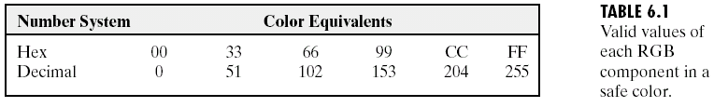
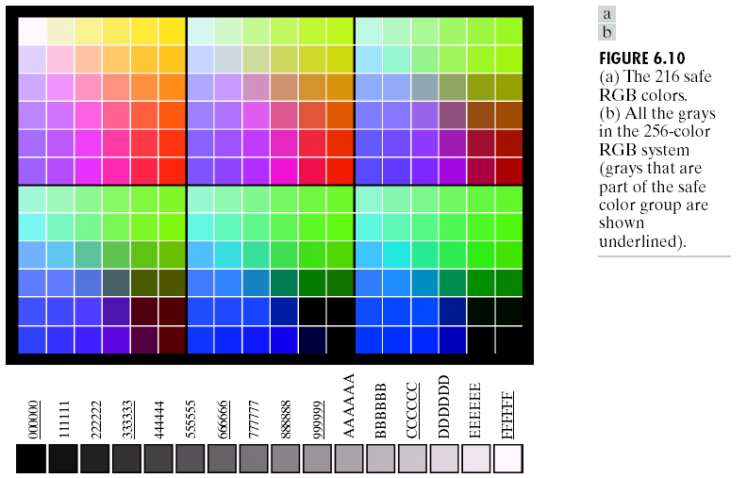
Generating RGB image

Slide 8
CMY and CMYK Color Model
Most devices that deposit color pigments on paper (such as Color Printers and Copiers) requires CMY data input or perform RGB to CMY conversion internally
C
M
Y
R
G
B
1.00
1.00
1.00
-
=

Slide 9
CMY and CMYK Color Model
CMY is a Subtractive Color Model
Equal amounts of Pigment primaries (Cyan, Magenta and Yellow) should produce Black
In practice combining these colors for printing produces a “Muddy-Black” color
So in order to produce “True-Black” a fourth color “Black” is added giving rise to CMYK model

Slide 10
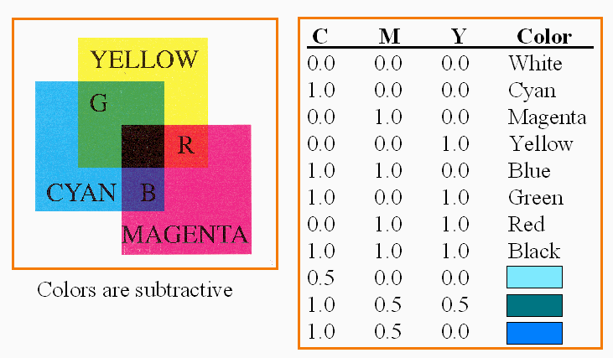
CMY Color Model

Slide 11
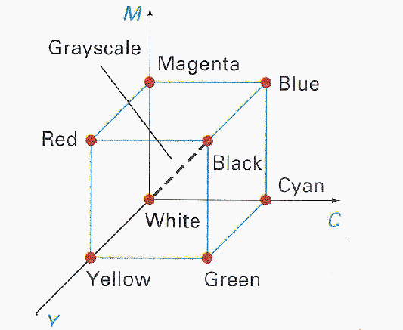
CMY Color Model

Slide 12
HSI Color Model
  Hue (dominant colour seen)
    Wavelength of the pure colour observed in the signal.
    Distinguishes red, yellow, green, etc.
    More the 400 hues can be seen by the human eye.
  Saturation (degree of dilution)
    Inverse of the quantity of “white” present in the signal. A pure colour has 100% saturation, the white and grey have 0% saturation.
    Distinguishes red from pink, marine blue from royal blue, etc.
    About 20 saturation levels are visible per hue.
  Brightness
    Amount of light emitted.
    Distinguishes the greylevels.
    The human eye perceives about 100 levels.

Slide 13
Properties of HSI (HSV)
Separates out intensity I from the coding
Two values (H & S) encode chromaticity
Convenient for designing colors

Slide 14
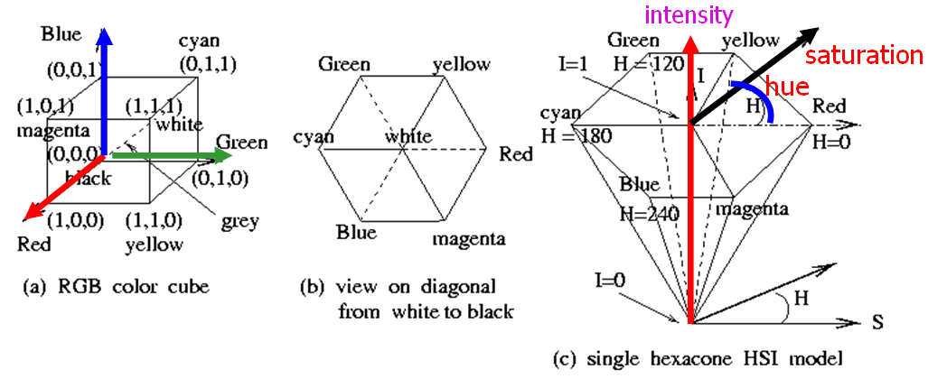

Slide 15
Properties of HSI (HSV)
I=(R+G+B)/3
Hue H is defined by an angle
Saturation S models the purity of the color
S=1 for a completely pure or saturated color
S=0 for a shade of “gray”

Slide 16

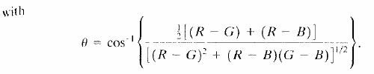
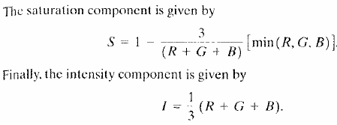
Conversion from RGB to HSI
Given an image in RGB color format, the H component of each RGB pixel is obtained using the equation:

Slide 17
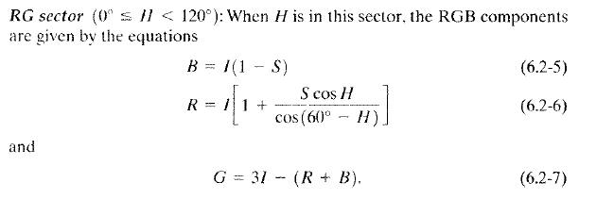
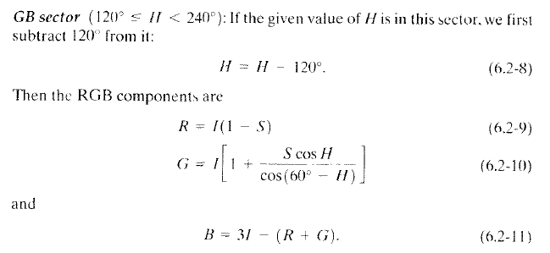
Conversion from HSI to RGB

Slide 18
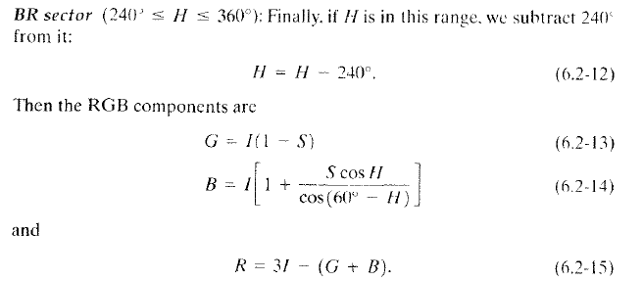
Conversion from HSI to RGB

Slide 19
Pseudo-Color Image Processing
Pseudo-color Image Processing consists of assigning colors to gray levels based on specific criterion
The principal for pseudo-color is for Human Visualization and Interpretation of Gray Scale events in an image or sequence of images

Slide 20
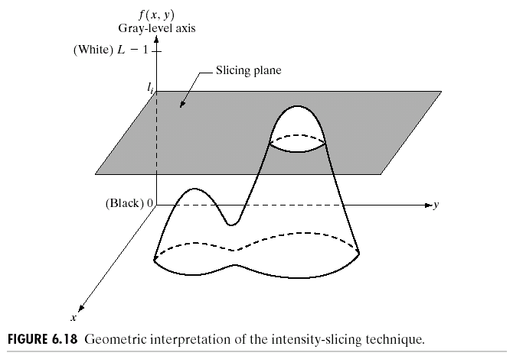
Intensity Slicing
Simplest technique for Pseudocolor image processing

Slide 21
Intensity Slicing
The Gray Scale [0,L-1] is divided into L levels; where l₀ represents Black (f(x,y)=0) and l_{L-1} represents white (f(x,y)=L-1)
Suppose that P planes perpendicular to the intensity axis are defined at levels l₁,l₂…..,l_{p}
Then assuming that 0<P<L-1 the P planes partition the gray scale into P+1 intervals, V₁,V₂…….V_{p+1}

Slide 22
Intensity Slicing
Gray level to color assignments are made according to the relation:
f(x,y)= c_{k} if f(x,y)€v_{k}
Where c_{k} is the color associated with the kth intensity interval v_{k} defined by the partition planes at l=k-1 and l=k

Slide 23
Intensity Slicing

Slide 24
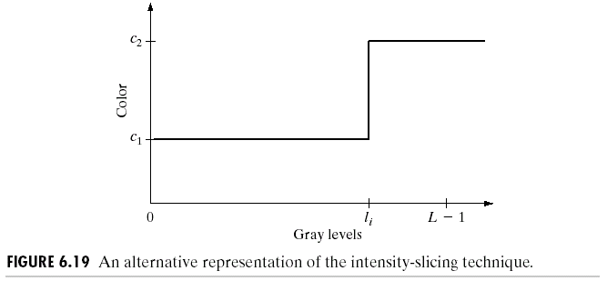
An Alternative View of Intensity Slicing

Slide 25
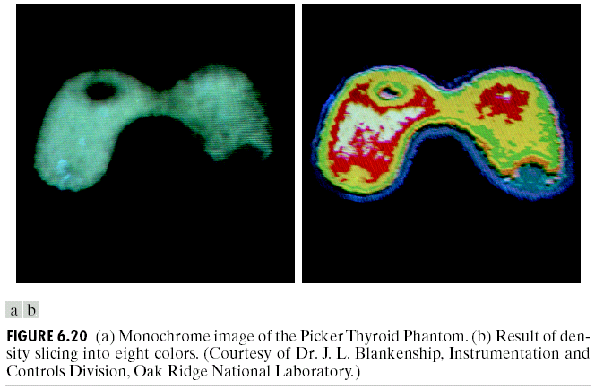

Slide 26
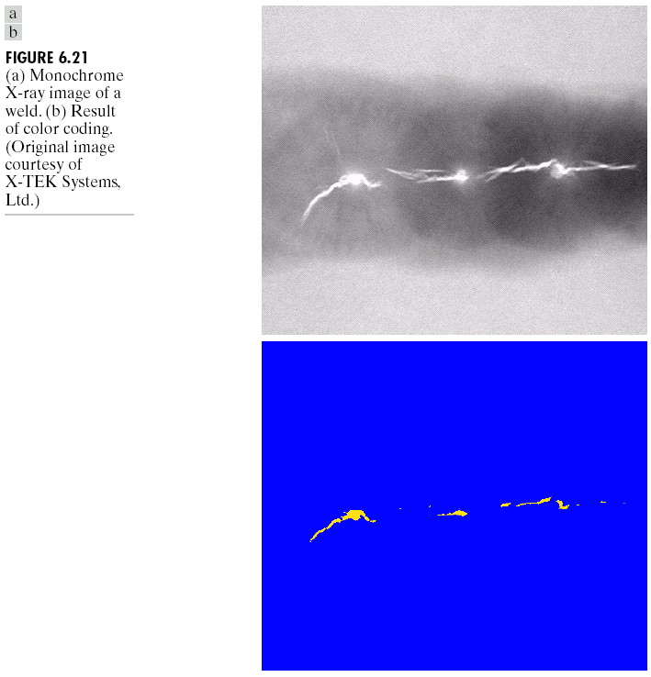

Slide 27
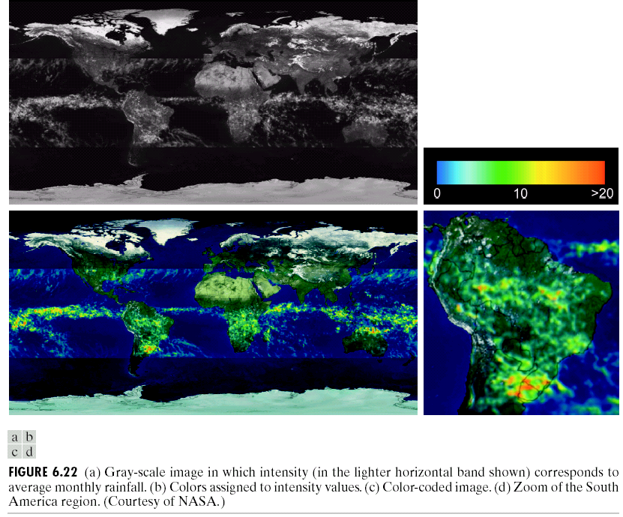

Slide 28
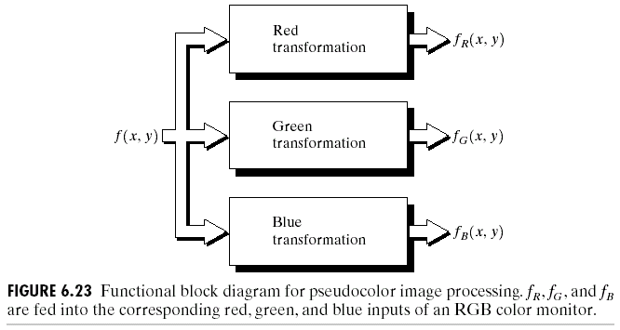
Gray level to Color Transformation

Slide 29
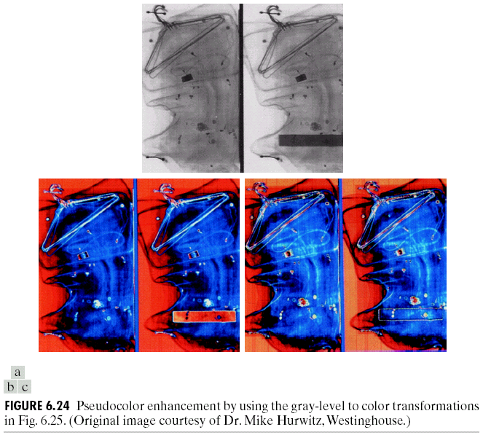

Slide 30
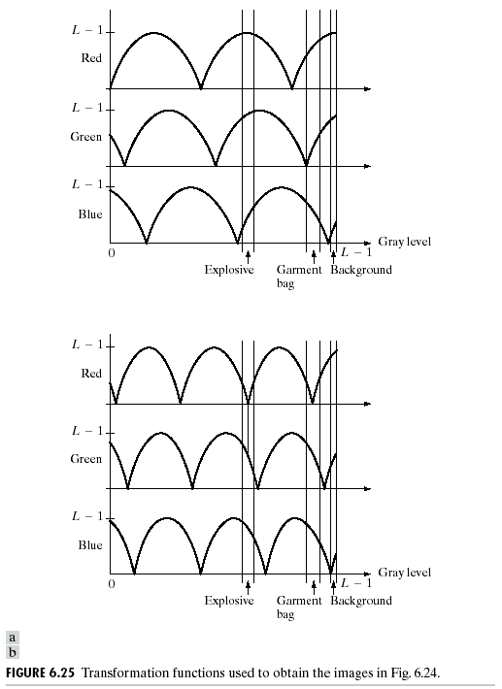

Slide 31
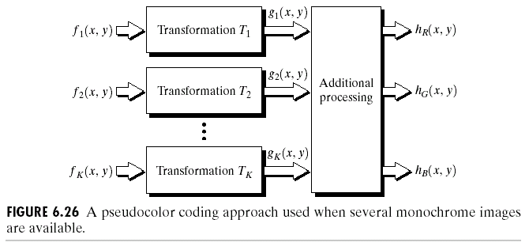
A Pseudo-color Coding Approach used when several Monochrome Images are available

Slide 32
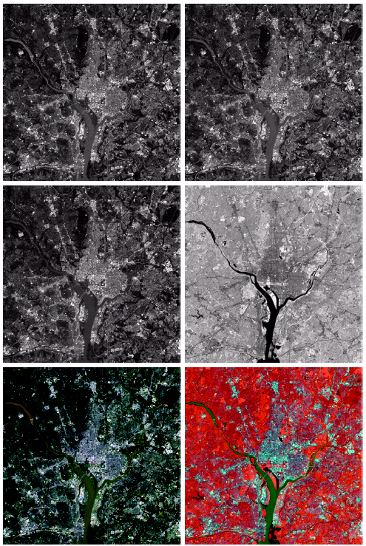


Slide 33
